Slide 1

Blockchain Technology
BC 2304 Mid Term Presentation
Presented by
MD. RAIHAN HOSSAIN
ID No. BC-23120414
Submitted by Shaikat Majumder,
Faculty at Creative IT Institute,
Blockchain Developer and Researcher,
Certified Trainer ToT,
Certified Associate NLP Practitioner

Slide 2
Welcome!!
The Presentation of
TCP/IP Model, Peer to Peer Networks, Digital Certificates

Slide 3
WHAT WE WILL LEARN HERE
TCP/IP Model
Definition of TCP/IP Model
Layer of TCP/IP Model
Peer to Peer Networks
Definition of P2P Networks
Types of P2P Networks
Digital Certificates
Definition of Digital Certificates
Encryption & Decryption
OSI Model & TCP/IP Model
Application of P2P Network (Blockchain)
Digital Signature & Digital Certificates

Slide 4
TCP/IP Model
TCP (Transmission Control Protocol) and IP (Internet Protocol). The main work of TCP/IP is to transfer the data of a computer from one device to another.
Layer of TCP/IP Model
Application Layer
Transport Layer(TCP/UDP)
Network/Internet Layer(IP)
Data Link Layer (MAC)

Slide 5
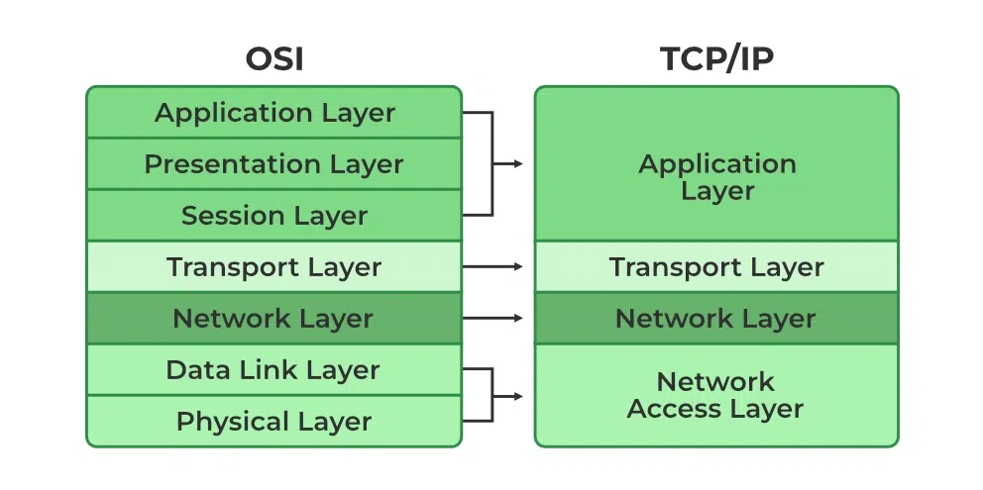
OSI Model & TCP/IP Model

Slide 6
Differences between OSI Model and TCP/IP Model
Parameters | OSI Model | TCP/IP Model
Full Form | OSI stands for Open Systems Interconnection. | TCP/IP stands for Transmission Control Protocol/ Internet Protocol.
Layers | It has 7 layers. | It has 4 layers.
Usage | It is low in usage. | It is mostly used.
Approach | It is vertically approached. | It is horizontally approached.
Delivery | Delivery of the package is guaranteed in OSI Model. | Delivery of the package is not guaranteed in TCP/IP Model.
Replacement | Replacement of tools and changes can easily be done in this model. | Replacing the tools is not easy as it is in OSI Model.
Reliability | It is less reliable than TCP/IP Model. | It is more reliable than OSI Mode

Slide 7
Peer to Peer Networks
In a peer-to-peer network, computers on the network are equal, with each workstation providing access to resources and data. This is a simple type of network where computers are able to communicate with one another and share what is on or attached to their computer with other users.
Types of P2P Networks
Unstructured P2P networks
Structured P2P networks
Hybrid P2P networks

Slide 8
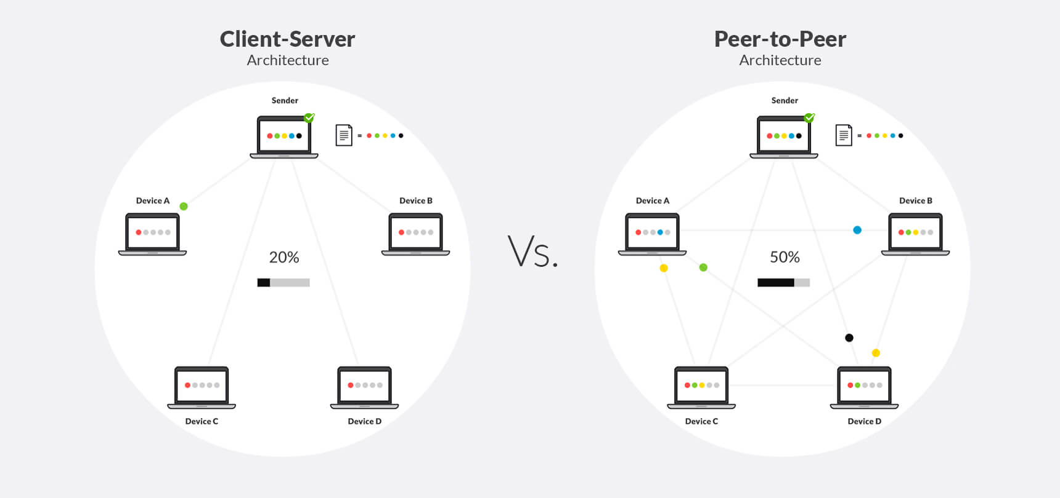
Application of P2P Network (Blockchain)
Centralized
Decentralized

Slide 9
Difference between Client-Server and Peer-to-Peer Network:
S.NO | Client-Server Network | Peer-to-Peer Network
1. | In Client-Server Network, Clients and server are differentiated, Specific server and clients are present. | In Peer-to-Peer Network, Clients and server are not differentiated.
2. | Client-Server Network focuses on information sharing. | While Peer-to-Peer Network focuses on connectivity.
3. | In Client-Server Network, Centralized server is used to store the data. | While in Peer-to-Peer Network, Each peer has its own data.
4. | In Client-Server Network, Server respond the services which is request by Client. | While in Peer-to-Peer Network, Each and every node can do both request and respond for the services.
5. | Client-Server Network are costlier than Peer-to-Peer Network. | While Peer-to-Peer Network are less costlier than Client-Server Network.
6. | Client-Server Network are more stable than Peer-to-Peer Network. | While Peer-to-Peer Network are less stable if number of peer is increase.
7. | Client-Server Network is used for both small and large networks. | While Peer-to-Peer Network is generally suited for small networks with fewer than 10 computers.

Slide 10
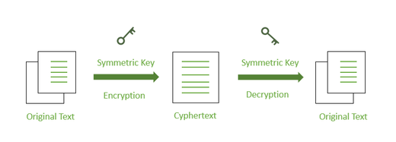
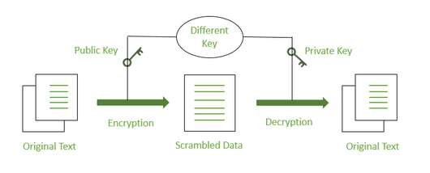
Digital Certificates
A digital certificate is a file or electronic password that proves the authenticity of a device, server, or user through the use of cryptography and the public key infrastructure (PKI).
A digital signature refers to a more secure electronic signature that is generated using a digital certificate and cryptographically bound to the document using public key infrastructure (PKI).
Encryption
Symmetric Encryption
Decryption
Asymmetric Encryption
Symmetric
Asymmetric

Slide 11
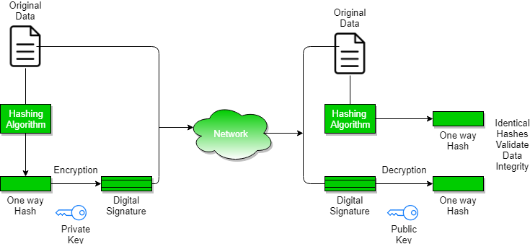
Digital Signature

Slide 12
Digital Signature & Digital Certificates
Feature | Digital Signature | Digital Certificate
Basics / Definition | A digital signature secures the integrity of a digital document in a similar way as a fingerprint or attachment. | Digital certificate is a file that ensures holder’s identity and provides security.
Process / Steps | Hashed value of original data is encrypted using sender’s private key to generate the digital signature. | It is generated by CA (Certifying Authority) that involves four steps: Key Generation, Registration, Verification, Creation.
Security Services | Authenticity of Sender, integrity of the document and non-repudiation. | It provides security and authenticity of certificate holder.
Standard | It follows Digital Signature Standard (DSS). | It follows X.509 Standard Format

Slide 13
Thank You!!

